Slide 1
Java Lab Assignment #4 Write a method that computes future investment value at a given interest rate for a specified number of years – Nicholas Carroll – 26 November 2018

Slide 2
Test Case 1 – proved on calculator
“Enter annual interest rate: “
“Enter the investment amount in integer form with no commas or decimals: “
“Enter the amount of years: “
Input: 4%, 15000, 7
Output:
Years | Future Value
9 | $19,837.71

Slide 3
Test Case 2 – proved on calculator
“Enter annual interest rate: “
“Enter the investment amount in integer form with no commas or decimals: “
“Enter the amount of years: “
Input: 8%, 8000, 9
Output:
Years | Future Value
9 | $16,396.24

Slide 4
Analysis – what is known and given?
Before we even think about coding specifics, we have to determine the objective (this is the first step used in an IPO diagram [input-process-output diagram]).
The desired output is a table to print two sections: Years and Future Value (of our investment based on accumulating interest). The process this is achieved is given below.

Slide 5
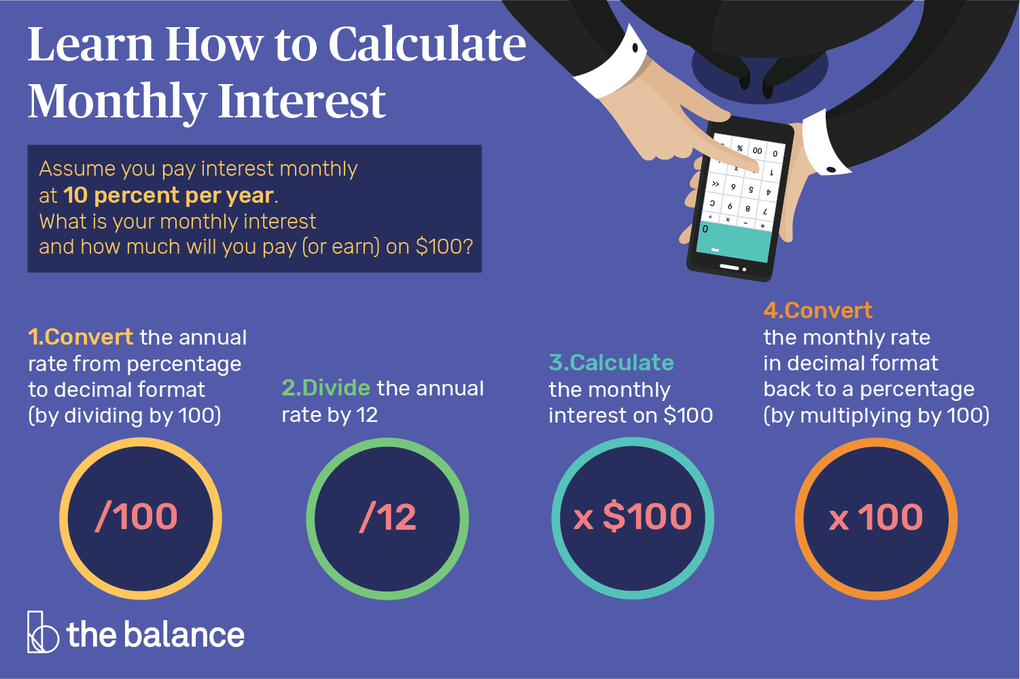
Example
Converting annual interest rate to monthly interest rate.

Slide 6
Analysis cont.
The compiler can calculate a value based on a base and exponent using the pow(a,b) method. Therefore, we have to import the Math and Scanner classes.
The program must run under a for loop, which means that it will repeat under certain condition or parameters. Before we declare the for loop, we must declare a loop control variable. Inside the parameters for the for loop, we have to make sure the variable (years) will begin at 1 and end at 30. It will increment by 1 or ++.

Slide 7
Algorithm
Create the package, import the Scanner and Math class respectively and create the main class.
Declare and initialize the necessary Scanner object to allow user input.
Declare three variables: yearlyInterestRate, investmentAmount, monthlyInterestRate and futureInvestmentEquation.
Declare and give arguments to futureInvestmentValue
End the main program.

Slide 8
Algorithm cont.
Begin a new method named futureInvestmentValue and give its respective parameters with data types.
Get user input for yearlyInterestRate and investmentAmount
monthlyInterestRate will be initialized to yearlyInterestRate divided by 100 then divided by 12.
Declare a for loop with a new variable called years and give it the parameters of equal to 1, less than or equal to 30 and incrementing by 1 or ++.

Slide 9
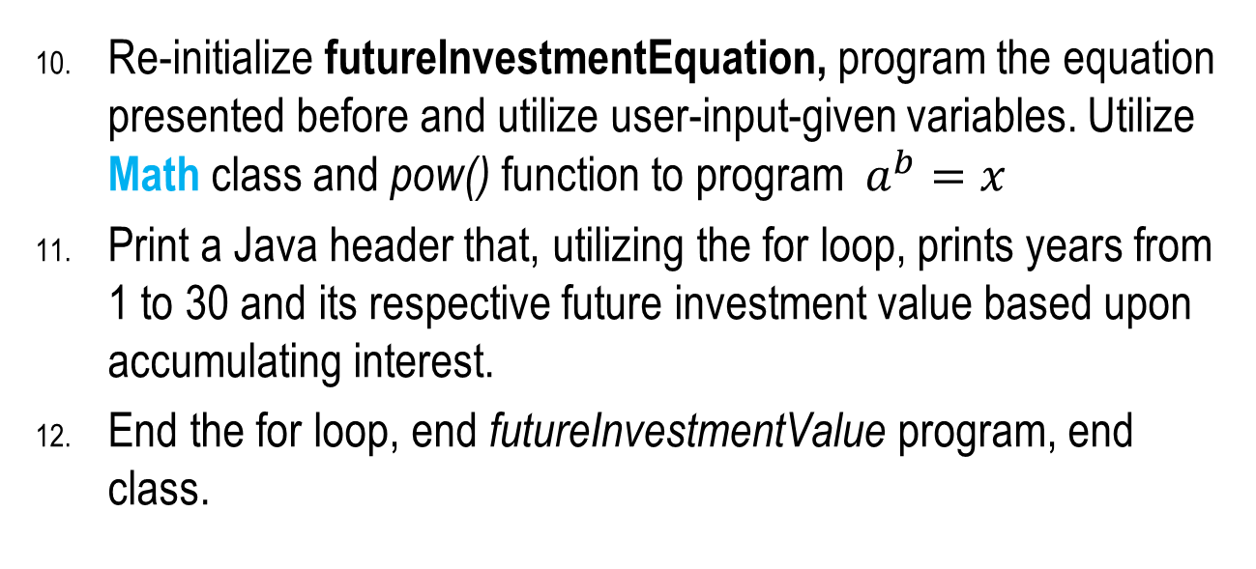
Algorithm cont.
Re-initialize futureInvestmentEquation, program the equation presented before and utilize user-input-given variables. Utilize Math class and pow() function to program $a^{b}=x$
Print a Java header that, utilizing the for loop, prints years from 1 to 30 and its respective future investment value based upon accumulating interest.
End the for loop, end futureInvestmentValue program, end class.

